Slide 1

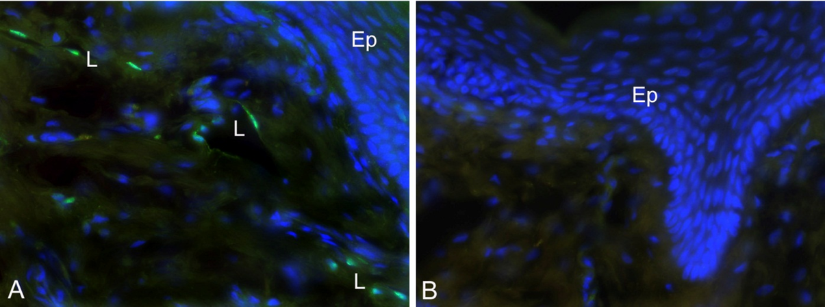
ReliaTech GmbH
Rabbit anti-human Prox-1
(Cat #102-PA32AG)
Immunofluorescence staining (green) of cryo-sections of human foreskin (fixed 15 min in 4% PFA) with anti-human Prox-1 (dilution 1:200) [Cat# 102-PA32AG] and counter staining of nuclei with Dapi. A) Note the specific green Prox-1 signal in the nuclei of lymphatics (L). Ep, epidermis. Specimen provided by Prof. Dr. J. Wilting, Goettingen.
The experiment was performed by the research group of Prof. Dr. J. Wilting and Dr. K. Buttler, University Göttingen, Germany.
http://www.reliatech.de / orders@reliatech.de

